Slide 1


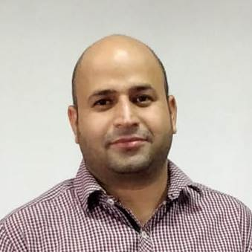
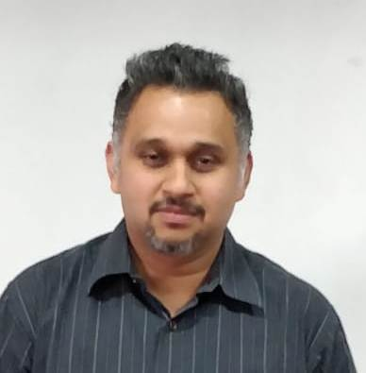



Online Banking – Group 2

Slide 2

Problem Statement
Online banking, also known as internet banking, it is an electronic payment system that enables customers of a bank to conduct a range of financial transactions through the financial institution's website.

Slide 3
Use case Diagram

Slide 4
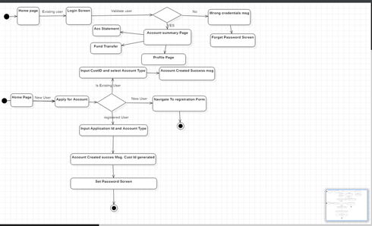
Activity Diagram

Slide 5
Assumptions and Scope of project
Account opening minimum balance is set to Rs 5000
On adding beneficiary, system is considering that the Account number, Beneficiary Name &IFSC Code are valid.
Details provided by the system user is considered valid.

Slide 6


Technologies, tools, frameworks with versions used in the project
JAVA 1.8
Spring Framework – 4.0.9
Angular - 6.0
JPA – 4.0.9
JUNIT – 4.9

Slide 7
Salient features of the project
Login
Registration
Add Account
Account Summary
User Profile
Account Statement
Add Beneficiary
View Beneficiary
Fund Transfer

Slide 8
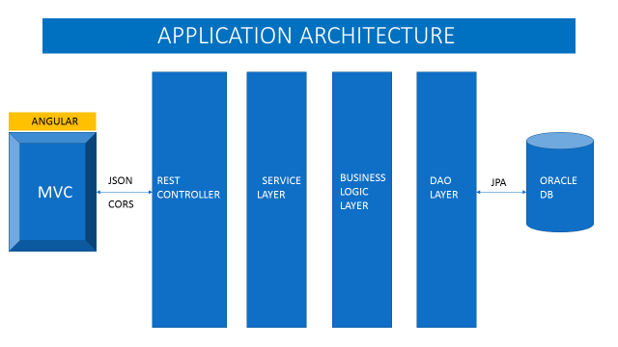
Application architecture

Slide 9
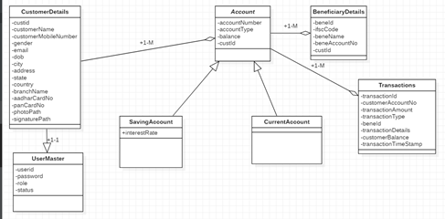
Class Diagram

Slide 10

What next? Future plan
Account Mini Statement
Delete Beneficiary
Forgot Password link on Login Screen

Slide 11


Thank you

